Slide 1
INTELLIGENT QUESTION TAGGING USING MACHINE LEARNING METHODS
Presented to:
Mr. Faisal Muhammad Shah
&
Mr. Sajib Kumar Saha Joy
Presented by:
Sean Rahman, ID-190104103
Saber Ahmed, ID-190104104
Rifat Bin Karim, ID-190104105
Hadayet Ullah Razu, ID-190104121

Slide 2
Agenda
Introduction
Dataset
Methodology
Data Preprocessing
Data Augmentation
Feature Extraction
Result Analysis
Conclusion and Future work

Slide 3
Introduction
Question Tagging
Problems of adding tags
Emphasize the utilization of machine learning

Slide 4
Dataset
Question Dataset:
Id
Owner User Id
Creation Date
Closed Date
Score
Title
Body
Figure: Overview of Questions Dataset

Slide 5
Dataset
Tags Dataset:
Id
Tags
Figure: Overview of Tags Dataset

Slide 6
Dataset
Question and Tag dataset are merged according to Id
Dataset Shape | Rows | Columns
Question Dataset | 1264216 | 7
Tags Dataset | 3750994 | 2
Merged Dataset (With respect to Id) | 1264216 | 8
Figure: Dataset Shape
Figure: Merged Dataset according to Id

Slide 7
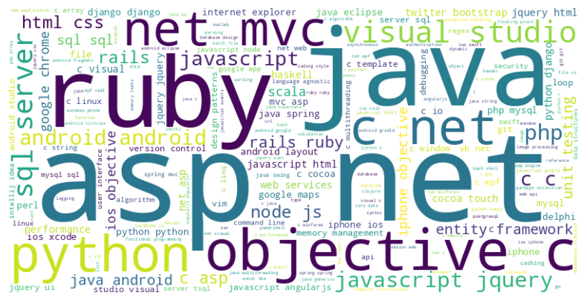
Dataset
Word Cloud for finding most common tags from all Tags
Figure: Word Cloud

Slide 8
Dataset
Figure: Collection of data where Score > 5
Figure: Dataset with respect to Most Common Tags

Slide 9
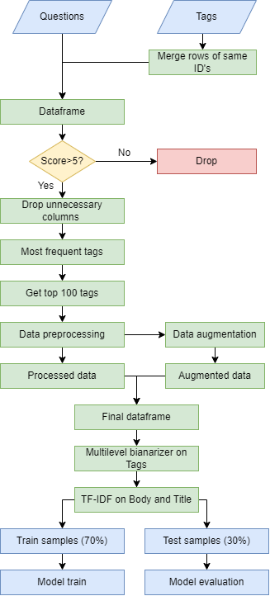
Methodology
Workflow:
Dataset merge and creation
Data Preprocessing
Data augmentation
Feature Extraction
Fitting in models
Evaluation metric and result analysis

Slide 10
Data Preprocessing
HTML tags remove
Contraction
Remove Punctuation
Lemmatization
Stop Word Remove
Multi-label Binarizer (Title)
Data Preprocessing are conducted both for Body column and Title column

Slide 11
Dataset Balancing
Imbalanced Dataset
Data Augmentation
Balanced Dataset
After Data Augmentation total data: 71264
Multi-label instances occurring only 1 time
Replicate instances by 2 times

Slide 12
Feature Extraction
Body
TF-IDF
Title
Body and Title column are stacked together. Then fitted in TF-IDF vectorizer

Slide 13
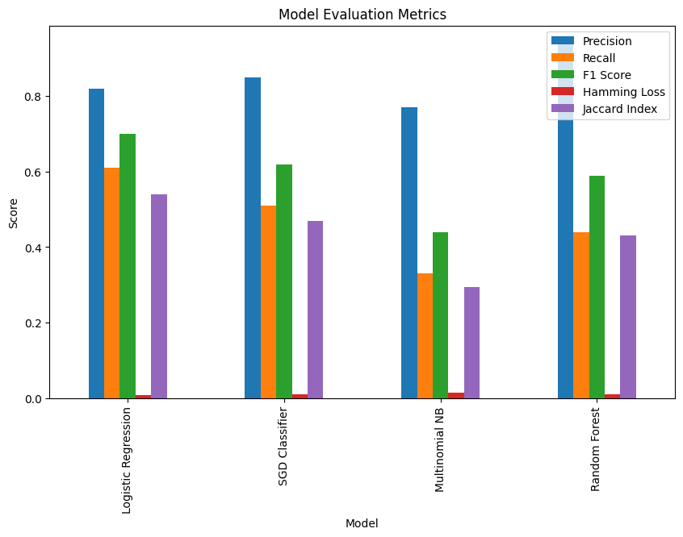
Result Analysis
Model | Precision | Recall | F1-Score | Hamming Loss | Jaccard Index
Logistic Regression | 0.82 | 0.61 | 0.70 | 0.008994 | 0.540778
SGD Classifier | 0.85 | 0.51 | 0.62 | 0.009983 | 0.469937
Mulitnomial NB | 0.77 | 0.33 | 0.44 | 0.013570 | 0.295254
Random Forest | 0.94 | 0.44 | 0.59 | 0.010195 | 0.431166
Figure: Evaluation Metrics of Models

Slide 14
Conclusion & Future work
Accurately classify tags.
Influence of different models.
Selection of models.
Use of Deep learning models.

Slide 15
Thank you !

